Slide 1



ALZHEIMER DISEASE PREDICTION USING DEEP LEARNING
BY:
SIVA SANKAR G - (312321205156)
SURYA R - (312321205171)

Slide 2

INTRODUCTION
EXISTING SYSTEM
DRAWBACKS
PROPOSED SYSTEM
AGENDA
PROPOSED SYSTEM ADVANTAGE
ARCHITECTURE
ADVANTAGES
OUTPUT
REFERENCES
CONCLUSION

Slide 3
INTRODUCTION
Alzheimer’s disease is an unpredictable degenerative brain disease.
Every 4 seconds someone in the world is diagnosed with Alzheimer’s disease the result is fatal as it leads to death.
The leading cause of AD is dementia, dementia causes a reduction in reasoning abilities interpersonal coping skills, and abilities to function independently.
The patient will forget the recent events in the early stage if the illness progresses they will gradually forget the whole event.
Therefore, diagnosing the disease as soon as possible is essential.
A model that takes a brain MRI sample image as input and determines whether a person has mild, moderate, very mild, or no dementia disease as output.

Slide 4
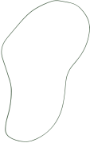

EXISTING SYSTEM
The Existing model used a Machine Learning algorithm with psychological parameters like age, number of visits, MMSE, and some other features, and by making use of all these they have created an ML model.
Existing Systems used algorithms such as Support Vector Machine(SVM), and Decision Tree algorithms for classifying Alzheimer’s disease.
Using all the above approaches they ended up achieving low accuracy.
In the existing, they also used the VGG19 model to classify Alzheimer’s disease in which the vanishing gradient problem is raised.
Also, Feature Propagation is not strengthened and the Reusability of the feature is not enhanced.
They did not take a step to reduce the number of parameters.

Slide 5

DRAWBACKS
LOW ACCURACY
VANISHING
GRADIENT
PROBLEM
FEATURE
PROPAGATION IS WEAK AND NOT ENHANCED
DID NOT TAKE STEPS TO REDUCE NUMBER OF PARAMETERS

Slide 6
PROPOSED SYSTEM
Here, we explore deep learning algorithms to identify and diagnose Alzheimer’s disease using MRI images of the human brain.
We collect the datasets from an open-source website called Kaggle. The dataset holds MRI images of the human brain in the affected person. For each category, we use 50 datasets. so a total of 200 datasets have been taken.
After the data set collection and pre-processing methods, we use and apply the following deep learning algorithms – Densenet169 algorithm classification for AD diagnosis.
This is an effective algorithm due to its better size and accuracy.
When the image is given as input It passes through a sequence of layers of dense blocks after every dense block layer there is a transition layer, convolutional layer, and Pooling layer which enhances the image pixels and reduce the size.

Slide 7
PROPOSED SYSTEM ADVANTAGE
Vanishing Gradient problem is alleviated by Densenet
Feature Propagation is strengthened
Reusability of feature is enhanced.
Number of the parameter is reduced.
Making use of all these we built this project to achieve high accuracy.

Slide 8
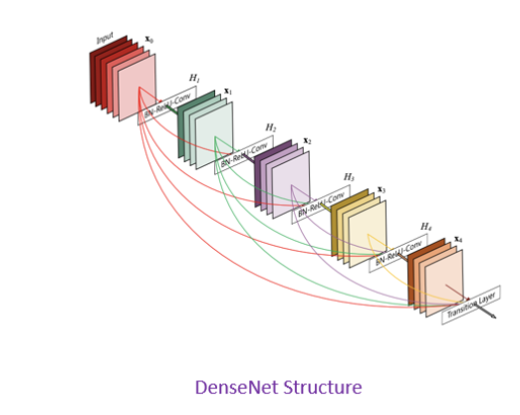
DENSE NET ALGORITHM

Slide 9
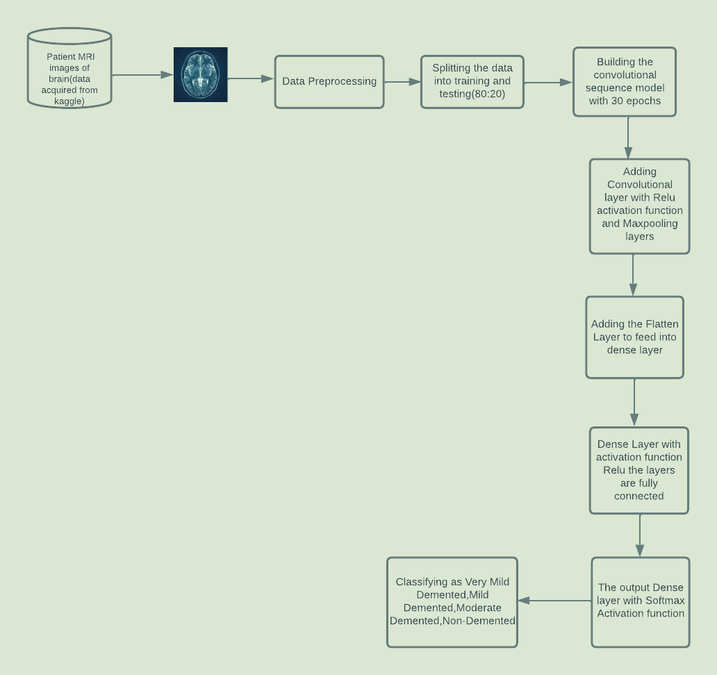
Proposed System Architecture :

Slide 10
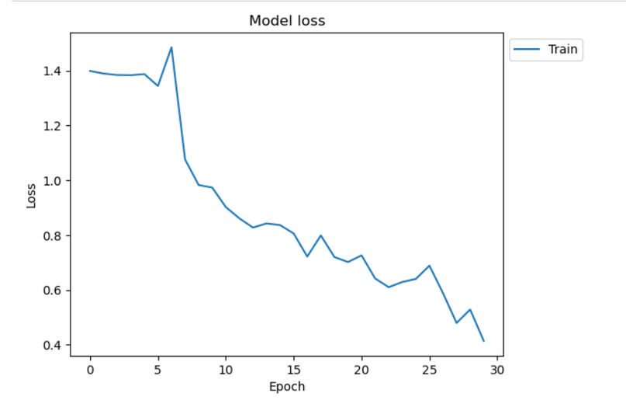
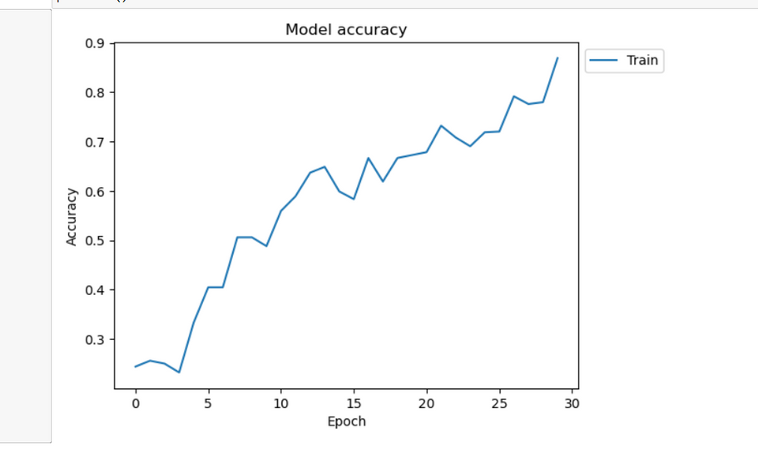
Performance Analysis :
The performance analysis of the DL algorithm are as follows :

Slide 11
CONCLUSION AND FUTURE SCOPE
In this paper we proposed a simple and robust classification approach of MRI scans for Alzheimer’s disease diagnosis. The approach is based on visual content description of anatomical structure of a brain region involved in AD ( hippocampal area). We proposed a late fusion of classification results on two biomarkers: hippocampus and CSF.
The experiments showed that combining hippocampus features and CSF amount classification gave better accuracy especially when discriminating between AD and MCI than when using either visual features or CSF volume separately for discriminating between AD and MCI than using either visual features extraction or CSF volume computation separately.
We also demonstrated that the proposed method provides better classification accuracy compared to other volumetric methods. In the perspective of this work we plan to use multiple ROIs, but also multiple MRI modalities in the established classification framework.

Slide 12
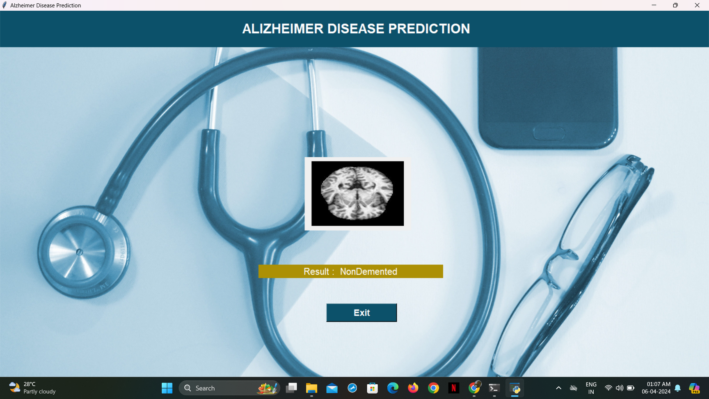

Output:

Slide 13


Slide 14


Slide 15


Slide 16

LITERATURE SURVEY:
S. No | Year & Author name | Title | Description | Advantages | Disadvantages
1. | 2021 | “Prediction of future Alzheimer's disease dementia using plasma phospho-tau combined with other accessible measures” by Blennow K et al. | The first approach is based on traditional classifiers,the second approach utilizes deep neural networks. | Utilizes waikato environment for knowledge analysis (WEKA) tool. | The paper is focused only on the machine learning and the accuracy is low.
2. | 2021 | “Application of Artificial Intelligence techniques for the detection of Alzheimer’s disease using structural MRI images” by Candice Ke En Ang et al. | Provides essential features required to detect fraudulent. | Random forest algorithm is very stable. | Speed during testing and application will suffer.
3. | 2021 | “A Deep Learning Model for Early Diagnosis of Alzheimer Diseases and Dementia from MR Images” by Chandran Venkatesan et al. | Hybrid methods which use AdaBoost and majority voting methods are applied. | Algorithms for clustering and classification were used separately. | Lack of confidentiality and lack of security of data.
4. | 2021 | “Alzheimer Disease Detection using Correlation based Ensemble Feature Selection and Multi Support Vector Machine” by Jhansi et al. | Describes probability of fraudulent transactions in prevalence and context of credit card usage. | Can handle large datasets helps in predicting the disease efficiently. | The customers credit card passwords, cvv numbers and other vital information are always vulnerable.

Slide 17

S. No | Year | Title | Description | Advantages | Disadvantages
5. | 2022 | “Alzheimers Disease Detection Using Different Machine Learning Algorithms” by T. Yamini | ML models detect Alzheimer’s early; Decision Trees excel but face scalability and image analysis challenges. | ML models detect Alzheimer’s early; Decision Trees excel but face scalability and image analysis complexity. | Machine learning models detect Alzheimer’s early; Decision Trees excel, but scalability and image analysis complexity pose challenges.
6. | 2022 | “Early-Stage Alzheimer's Disease Prediction Using Machine Learning Models “ by C Kavitha | ML applied to OASIS data predicts Alzheimer's with 83% accuracy, outperforming previous methods. | ML algorithms on OASIS data enable earlier Alzheimer's detection, improving treatment efficacy. | reliance on imaging data, which may not capture all aspects of Alzheimer's progression, potentially leading to incomplete or inaccurate predictions.
7. | 2022 | “Early prediction of Alzheimer's disease using convolutional neural network: a review” by Vijeeta Patil | This paper reviews Alzheimer’s disease, focusing on ML methods for early detection. It highlights the superiority of 18-layer CNN for ADNI data. | Enhanced early Alzheimer's detection using advanced machine learning techniques. | Limited exploration of alternative machine learning methodologies.
8. | 2022 | “Deep Learning-Based Diagnosis of Alzheimer’s Disease” by Fan Wu | AD, a major concern in healthcare, utilizes deep learning for diagnosis, showing promise despite existing challenges. | Deep learning enhances AD diagnosis accuracy, outperforming conventional methods. | The paper fails to pay attention to unsupervised practices,which can uncover new insights.

Slide 18
S. No | Year | Title | Description | Advantages | Disadvantages
9 | 2023 | “A Novel Approach Utilizing Machine Learning for the Early Diagnosis of Alzheimer's Disease” by Mir Jafkul Alam | ML detects Alzheimer’s; Decision Trees excel, scalability/image complexity challenge. | ML detects Alzheimer’s early; Decision Trees excel, scalability poses challenges. | ML detects Alzheimer’s; Decision Trees excel but scalability poses challenges.
10 | 2023 | “A systematic review on machine learning and deep learning techniques in the effective diagnosis of Alzheimer’s disease” by Prasun Chakarabart | Study reviews machine learning in AD diagnosis via PET and MRI modalities, assessing classifier performance. | Systematic review assesses PET and MRI in AD classification, leveraging diverse classifiers. | Study identifies PET and MRI limitations in AD classification with various classifiers.
11 | 2023 | “A systematic review on machine learning and deep learning techniques in the effective diagnosis of Alzheimer’s disease” by Javed Rahabi | AD's diagnosis aided by PET, MRI, ML, and DL; crucial for early classification and treatment decisions. | Early AD diagnosis enables timely intervention, potentially delaying progression and improving patient outcomes. | Limited effectiveness in halting AD progression despite early diagnosis and intervention.

Slide 19
Thank you!

